Slide 1
DON’T CHANGE THE GRIDS… MAKE THEM LAST LONGER!

Slide 2
What is LASER SHIELD?
LASER SHIELD is an eco-friendly liquid that is applied using a professional sprayer on laser cutting grids. Once sprayed on clean grids, LASER SHIELD creates a durable protective barrier that resists heat, sparks, and oxidation, extending their lifespan.

Slide 3
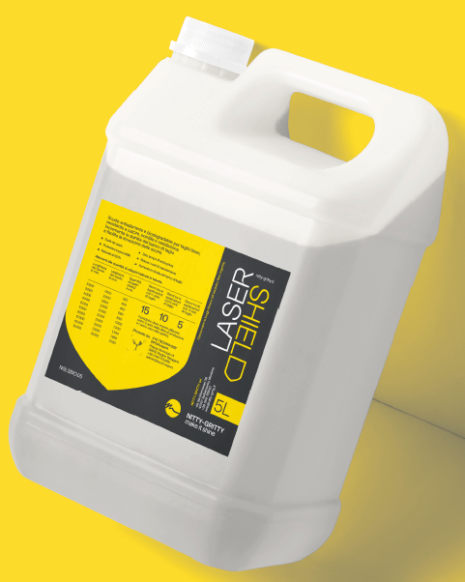
Why use LASER SHIELD?
LASER SHIELD acts on the grids by forming a protective shield for laser cutting surfaces, ensuring greater durability over time and leading to:
DIRECT REDUCTION OF PRODUCTION COSTS
No need to replace the cutting table
No machine downtime
QUALITY IMPROVEMENT
Enhanced machine performance
ENVIRONMENTAL FRIENDLINESS
The product is non-hazardous, eco-friendly, and 100% biodegradable.

Slide 4
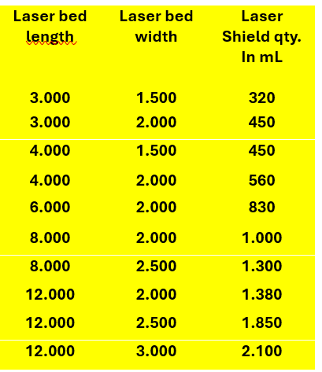
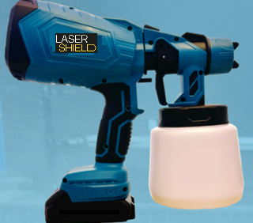
How to use LASER SHIELD?
LASER SHIELD should be poured into the sprayer container and applied by spraying it onto the grids in the following ratios:
The treatment lasts for 15 work shifts.

Slide 5
LASER SHIELD
LASER SHIELD has the following technical features:
✅ NON-FLAMMABLE ✅ ECO-FRIENDLY ✅ BIODEGRADABLE ✅ NON-HAZARDOUS ✅ TESTED UP TO 50 kW POWER ✅ TESTED UP TO 100 mm THICKNESS ✅ COMPATIBLE WITH VARIOUS MATERIALS ✅ SHELF LIFE: 24 months (sealed) | 12 months (after opening)

Slide 6
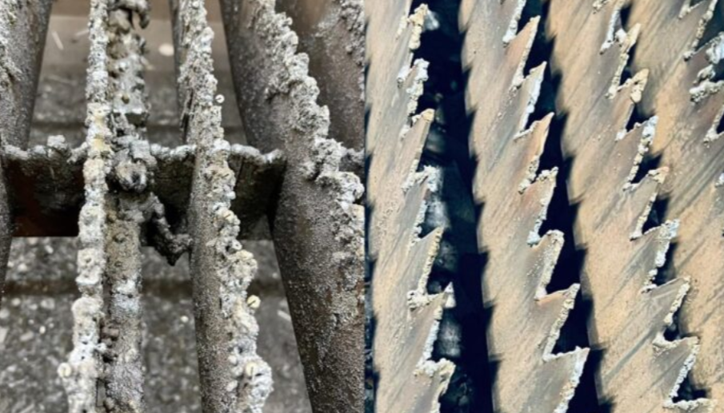
LASER SHIELD Performance Test
TEST PERFORMED BY THE SUPPLIER ON A TABLE FOR 16 DAYS
Without LASER SHIELD
2/3 hours needed for cleaning
With LASER SHIELD
Work continues without interruptions

Slide 7
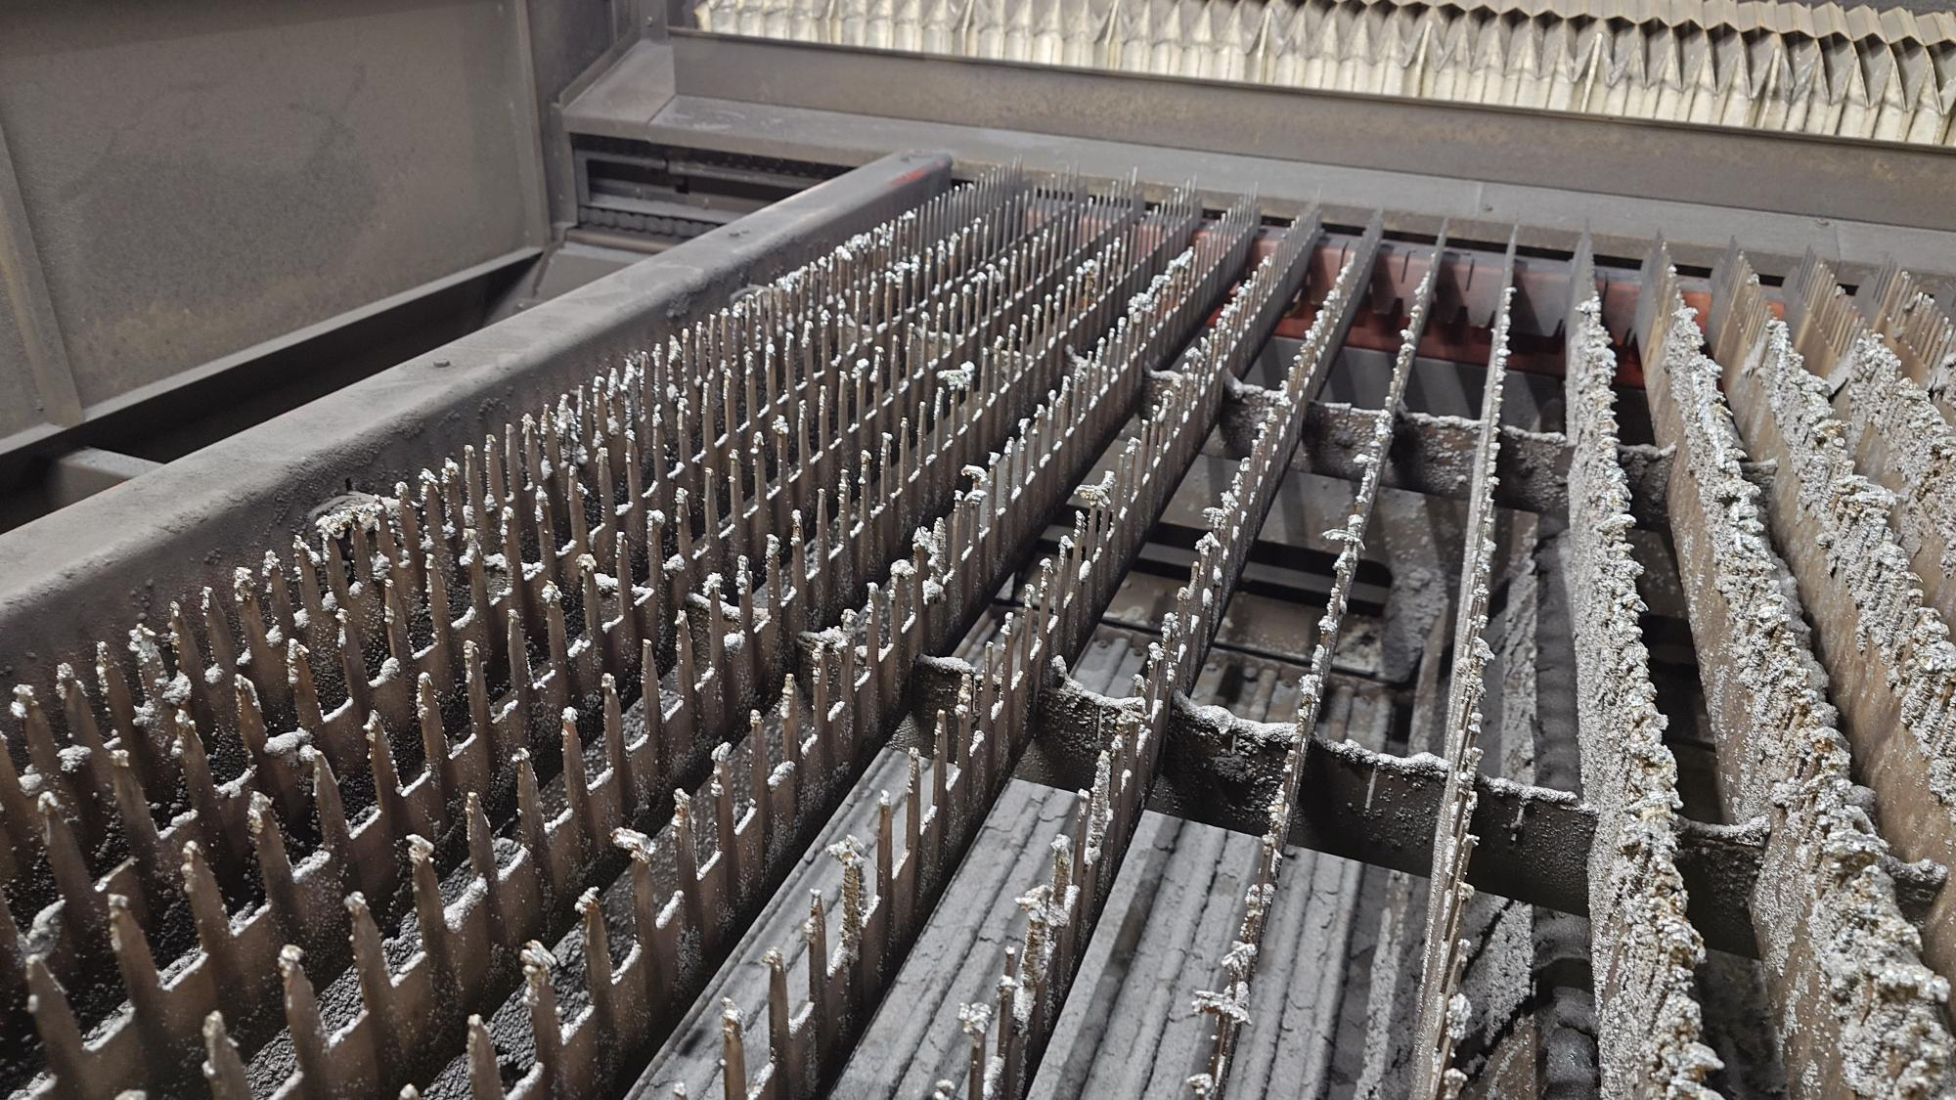
LASER SHIELD Performance Test
TREATED AREA WITH LASER SHIELD UNTREATED AREA

Slide 8
LASER SHIELD Market
LASER SHIELD can be offered to all final customers using CLINOX products, as most of them are metalworking companies involved in sheet metal cutting. Additionally, CLINOX dealers typically serve the same type of customers in the carpentry sector. One certainty is that the issue of grid cleaning is real and a major challenge for metalworking companies.

